Slide 1
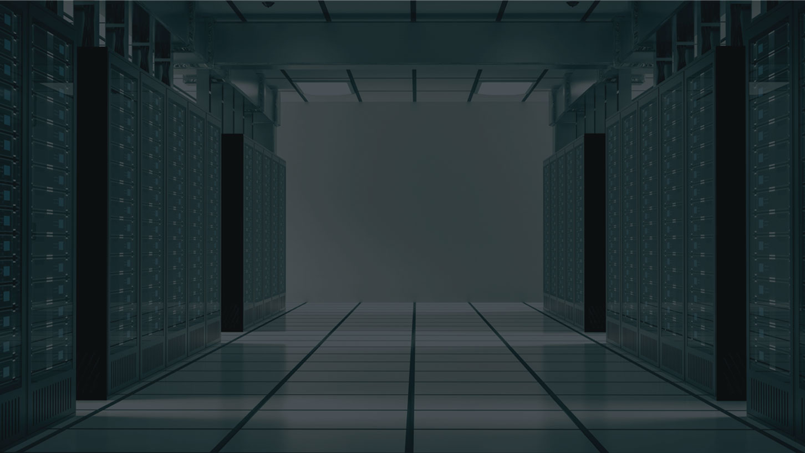

IT Management, Simplified
Real time IT management solutions for the new speed of business

Slide 2
Desktop Central
In IT managers' perspective

Slide 3

Agenda
About ManageEngine
About Desktop Central
Product overview

Slide 4



ManageEngine - the Enterprise IT Management division of ZOHO Corporation
Privately held, profitable since inception
(Est. 1996)
(Est. 2002)
(Est. 2005)
(Est. 1996)
Applications for
Business, Collaboration,
and Productivity
Enterprise IT
Management
Solutions
Network
Management
Framework

Slide 5







Some of our other solutions
Active Directory Management
Active Directory
Exchange Server
Self-Service Portal
Recovery and Backup
IT Security
Log Management
Firewall Analysis
Vulnerability Analysis
Privileged Password
Network Anomaly Detection
IT Service Management
Help Desk
Asset Lifecycle
CMDB and ITIL
Customer Support
End Point Management
Desktops Management
MDM and BYOD Policies
OS Deployments
IT Operations
Management
Network Performance
Application Performance
End user Experience
Network Change and Configuration
Converged Infrastructure
Storage Infrastructure
Bandwidth and Traffic
SQL Server Monitoring
On Demand Solutions
Application Performance
Helpdesk Software
Active Directory Recovery
and Backup
Mobile Device Management

Slide 6







2 Million Users
3 of every 5 Fortune 500 companies are ManageEngine
customers

Slide 7


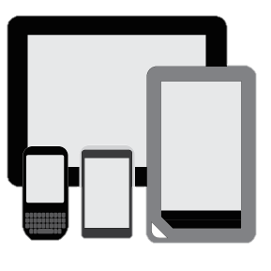
Unified Endpoint Security and Management
Product Overview

Slide 8
Desktop Central is a unified endpoint management solution that helps in managing servers, laptops, desktops, smartphones, and tablets from a central location.
Patch management
Software deployment
Asset management
Configurations & Tools
Imaging & OS Deployment
Remote control
Audits & Reports
Mobile Device Management
Security
Management

Slide 9
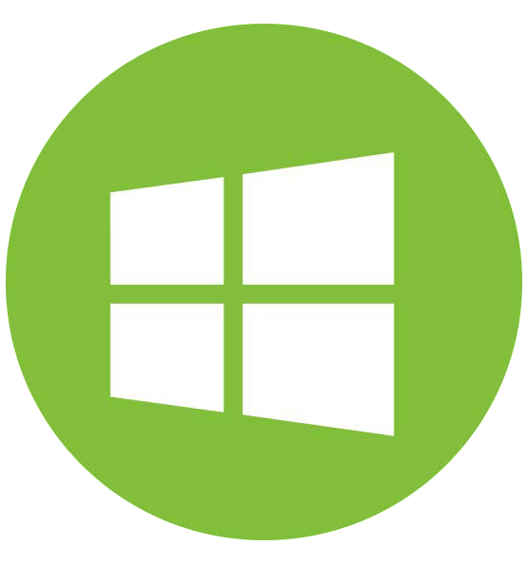


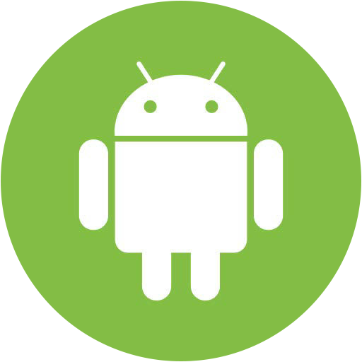
Supported OS
Desktops & Laptops
Mobile devices

Slide 10
Feature Highlights
Patch Management: Automate patching Windows, Mac, Linux & 3rd party applications
Software Deployment: Remotely install/uninstall free & commercial software to users & computers
Remote Control: HIPAA compliant, advanced remote control with video recording, file transfer etc.
Imaging & OS Deployment: Customized Templates, Deploy drivers, Post-deployment configurations
Tools: System tools, announcement, chat & system manager
Configurations: 30+ configurations for Windows, Mac & Linux
Asset Management: Real-time hardware and software inventory
Security Management: Secure USB, Prohibit Software, Block Exe, Configure Firewall & Ports.
Reports: Out of the box pre-defined & custom reports which can be scheduled
Mobile Device Management:Manage iOS, Android & Windows devices.

Slide 11
Pricing
Desktop Central is available as :
  Free edition
  Professional Edition
  Enterprise edition
  UEM Edition
  Pricing details can be seen here:
  https://store.manageengine.com/desktop-central/

Slide 12











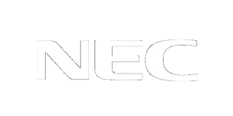


Some of our clients

