Slide 1


Applications Manager Overview

Slide 2
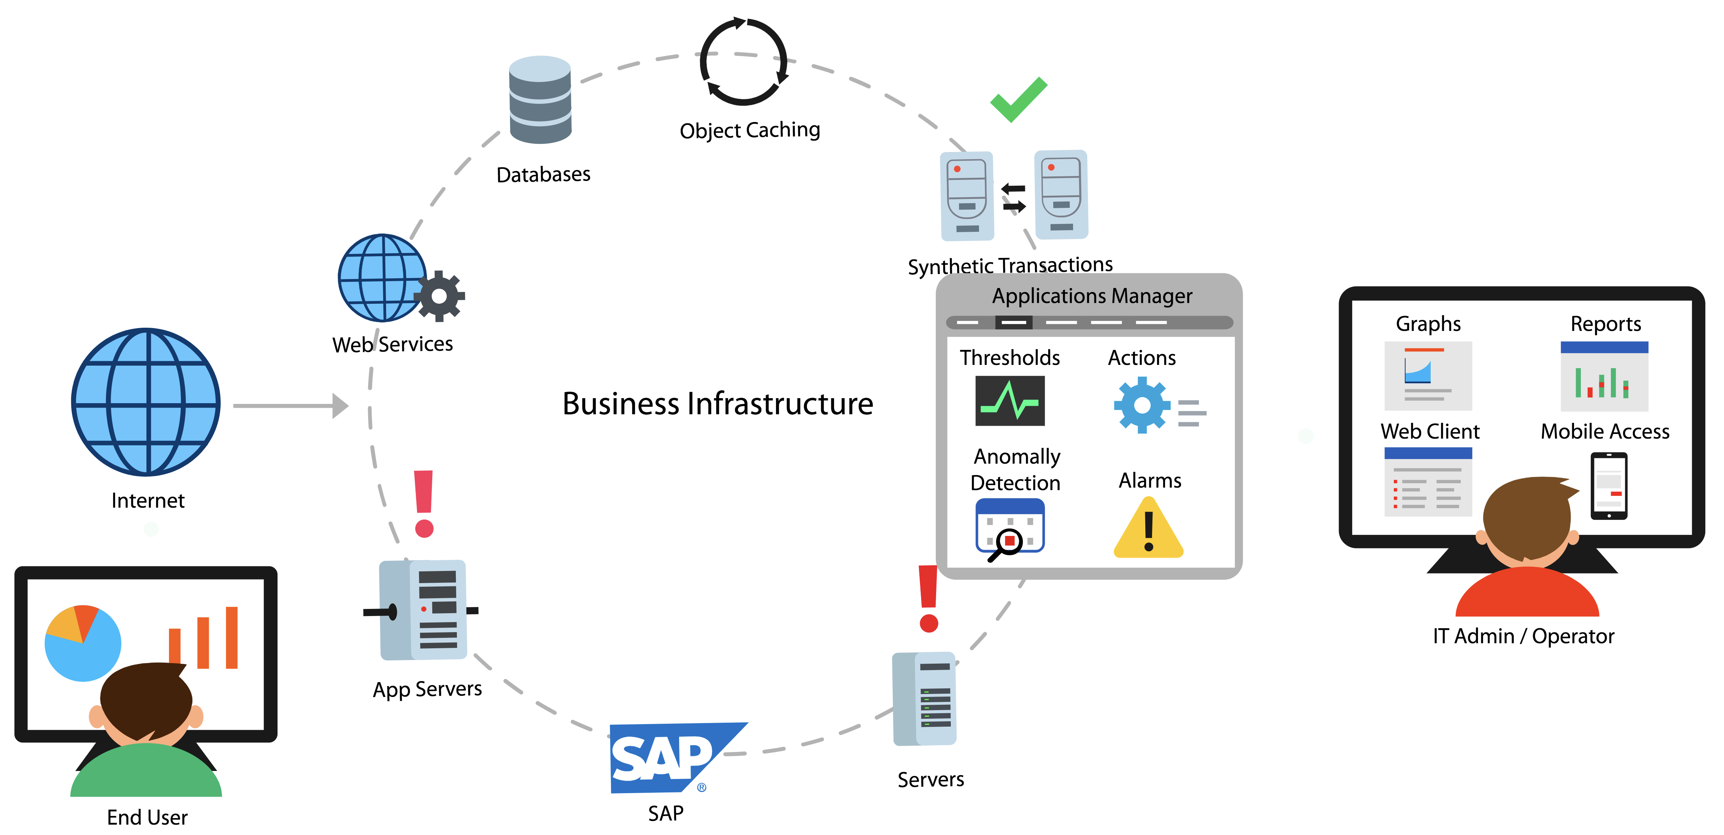
Applications Manager
Apps + infrastructure + user experience monitoring: all from a single console
Notes:
Agentless, Editions, Supported database backend.

Slide 3
Who uses Applications Manager
IT Operations
DevOps Engineers
Site Reliability Engineers
DBAs
Production Support
CloudOps
Architects
Anyone who is responsible for application performance
Notes:
It is a minute after midnight and the site goes live. Soon after, users complain of several problems. The site is not reachable due to increased traffic. Even if the site is reachable for some people, the landing page appears to be slow. Customers who click on Mobiles and Tablets category leads to HTTP 500 internal server error. Some pages lead to a HTTP 502 bad gateway error. Whatever happened to the Electronics page!! This was nothing short of a disaster..

Slide 4






Application Performance
Monitoring
Find and fix performance issues across your entire application stack
APM
Notes:
GroupsRule EngineCommon configuration

Slide 5






Transactions
Traces
Get complete insight into
Database Calls
Exceptions
Exceptions

Slide 6





APDEX
Transaction details and code level diagnostics
Track KPIs of
applications
Response time
Throughput
Notes:
GroupsRule EngineCommon configuration

Slide 7

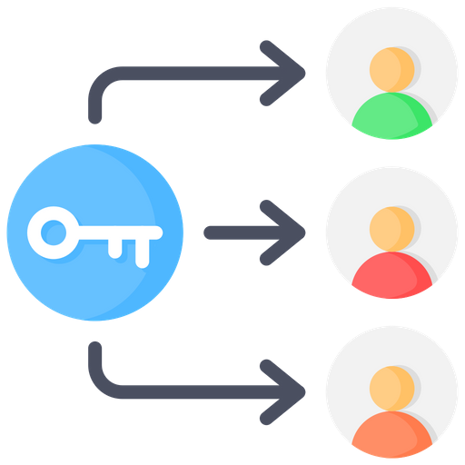


Identify problems such as
USER SESSION
BLOCKED QUERIES
WAITS
LOCKS

Slide 8
Infrastructure monitoring
Monitor the IT infrastructure that powers your applications
Notes:
GroupsRule EngineCommon configuration

Slide 9

Out-of-the box support for 150+ applications
Databases
Servers
App servers, web servers, services
VMs, converged infrastructure
Containers
Cloud apps
ERP
Middleware

Slide 10
More on infrastructure monitoring
Monitor IT infrastructure metrics alongside APM and distributed traces in a single, integrated platform - without having to switch between multiple tools.
Supports monitoring of both on premise and cloud infrastructure
Agentless monitoring
Supports both modern apps such as Kubernetes and legacy servers such as AS/400
Vendor agnostic: Supports popular commercial vendors such as Microsoft, Oracle, SAP, IBM, AWS, and VMware as well as open source such as Apache and Red Hat.
Notes:
It is a minute after midnight and the site goes live. Soon after, users complain of several problems. The site is not reachable due to increased traffic. Even if the site is reachable for some people, the landing page appears to be slow. Customers who click on Mobiles and Tablets category leads to HTTP 500 internal server error. Some pages lead to a HTTP 502 bad gateway error. Whatever happened to the Electronics page!! This was nothing short of a disaster..

Slide 11

End User Monitoring
Notes:
GroupsRule EngineCommon configuration

Slide 12
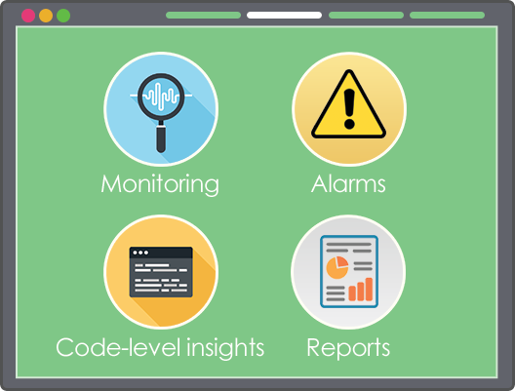

Real Browser Monitoring
Run synthetic transactions to simulate user experience with your site
Test applications/ features before launch
Collect information across geographies
Notes:
It is a minute after midnight and the site goes live. Soon after, users complain of several problems. The site is not reachable due to increased traffic. Even if the site is reachable for some people, the landing page appears to be slow. Customers who click on Mobiles and Tablets category leads to HTTP 500 internal server error. Some pages lead to a HTTP 502 bad gateway error. Whatever happened to the Electronics page!! This was nothing short of a disaster..

Slide 13

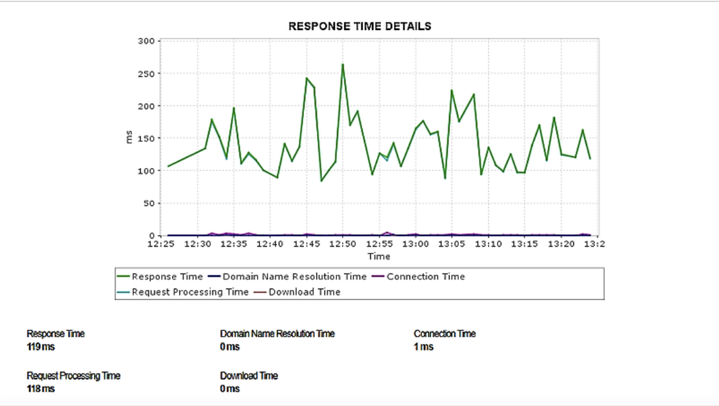


Monitor availability and response time of your REST API endpoints
Notes:
Applications manager enables you to proactively monitor your REST APIS for performance and functional correctness.

Slide 14
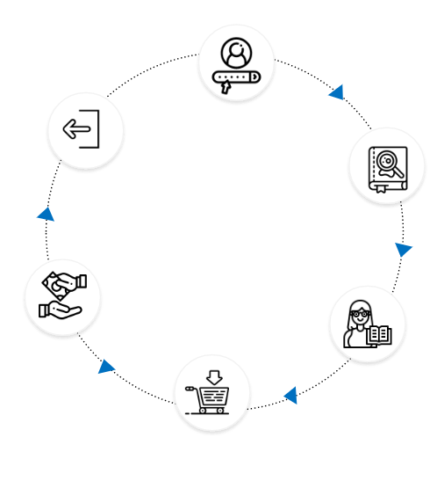
Real User Monitoring
Capture user’s transaction with a website in real time.
Analyze front end performance across geographies.
Manage service quality delivered to clients.

Slide 15
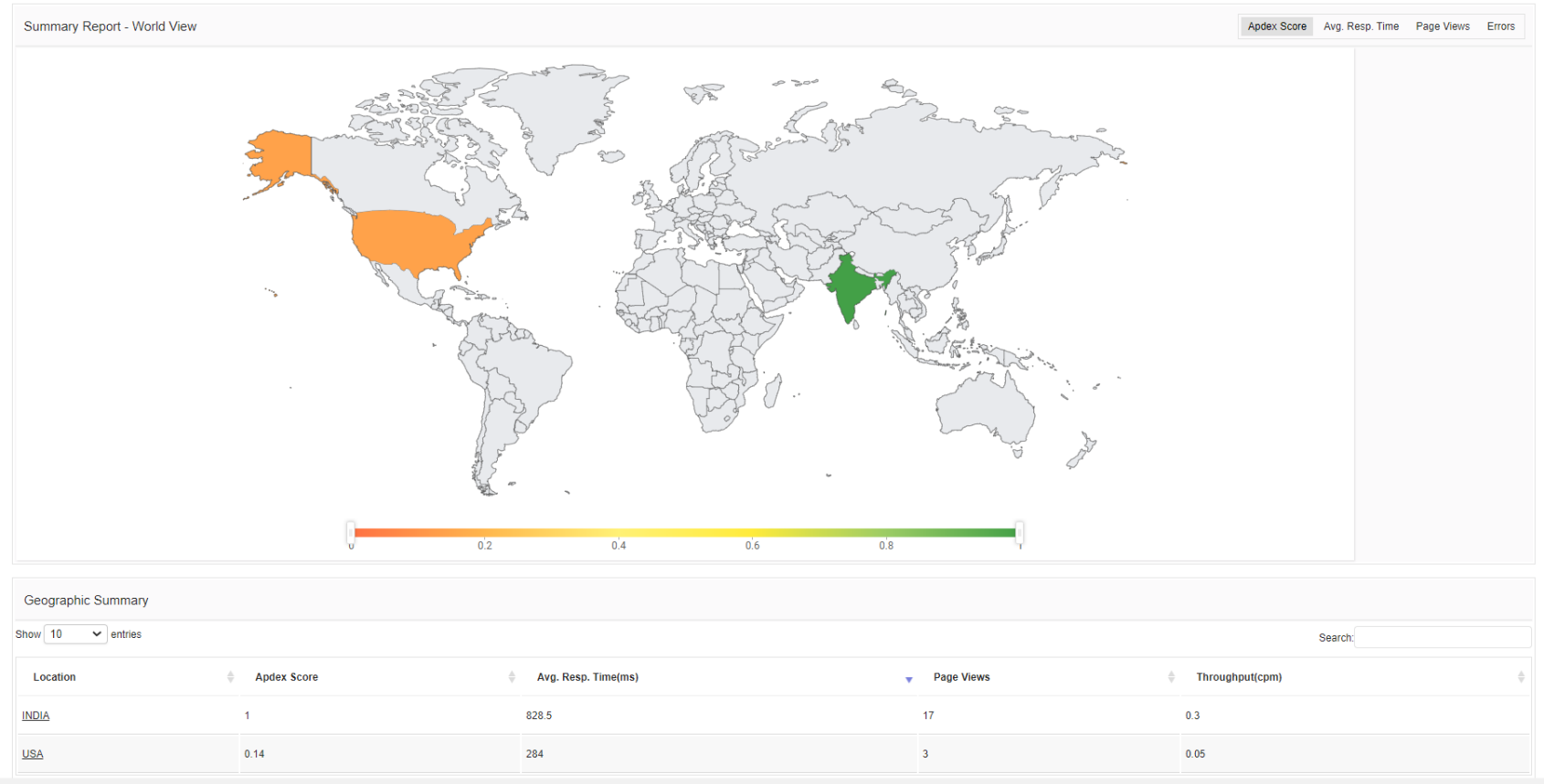
Real User Monitoring

Slide 16
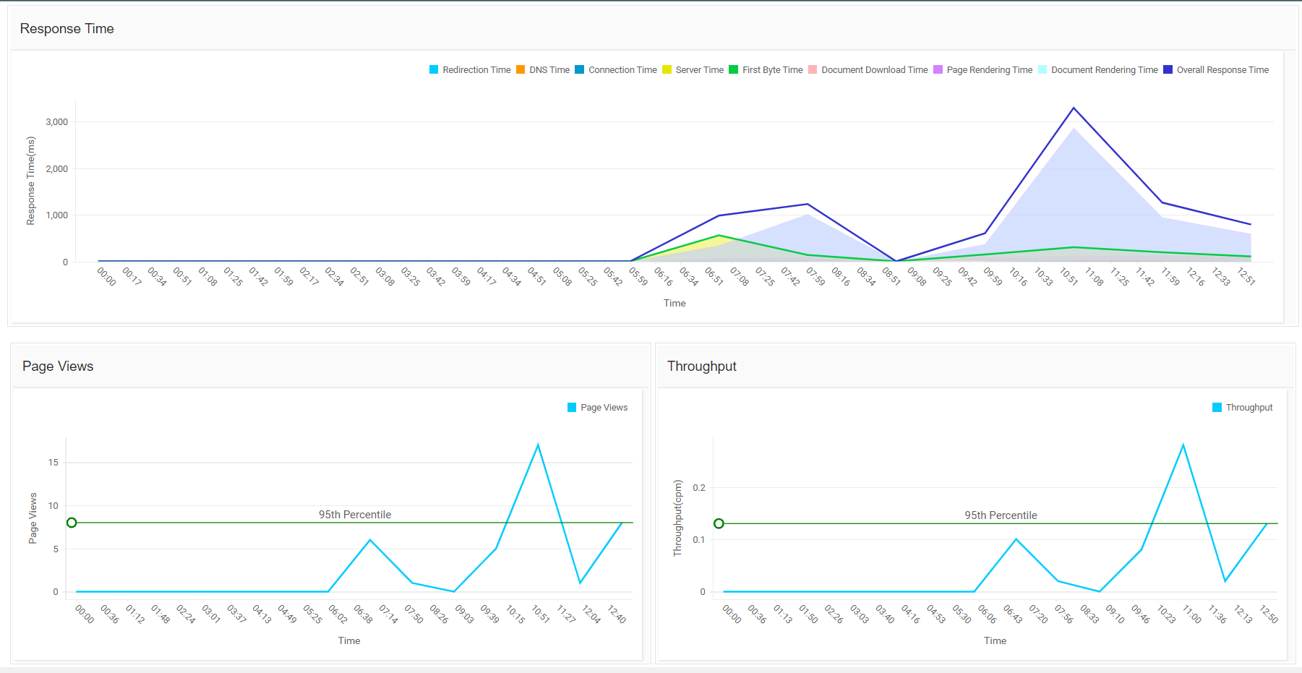
Real User Monitoring

Slide 17







Other features
Notes:
GroupsRule EngineCommon configuration

Slide 18
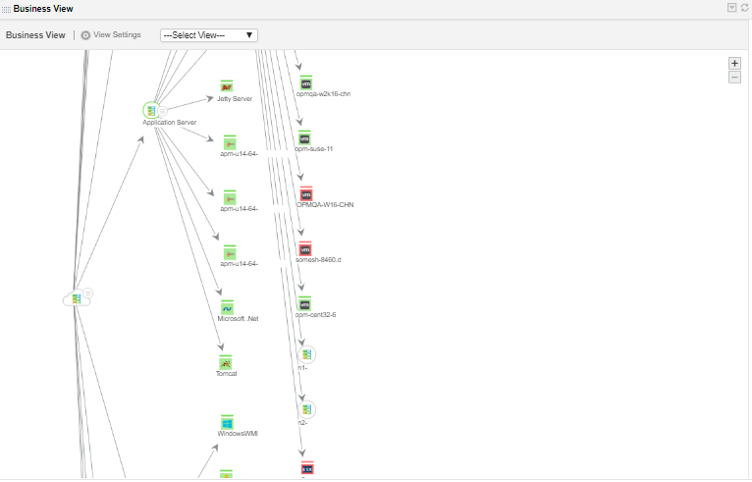
Automatic Discovery and Dependency Mapping

Slide 19
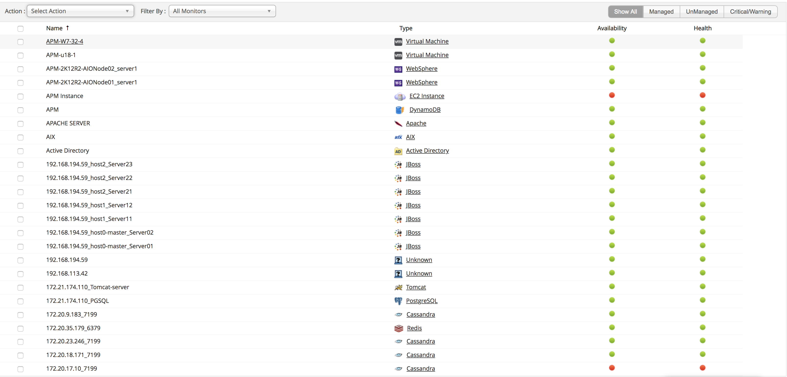
Business Service Management

Slide 20
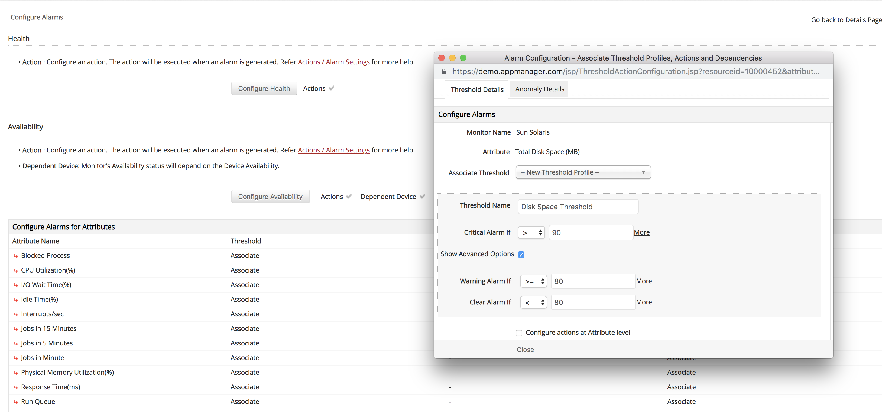
Real-time Notifications

Slide 21
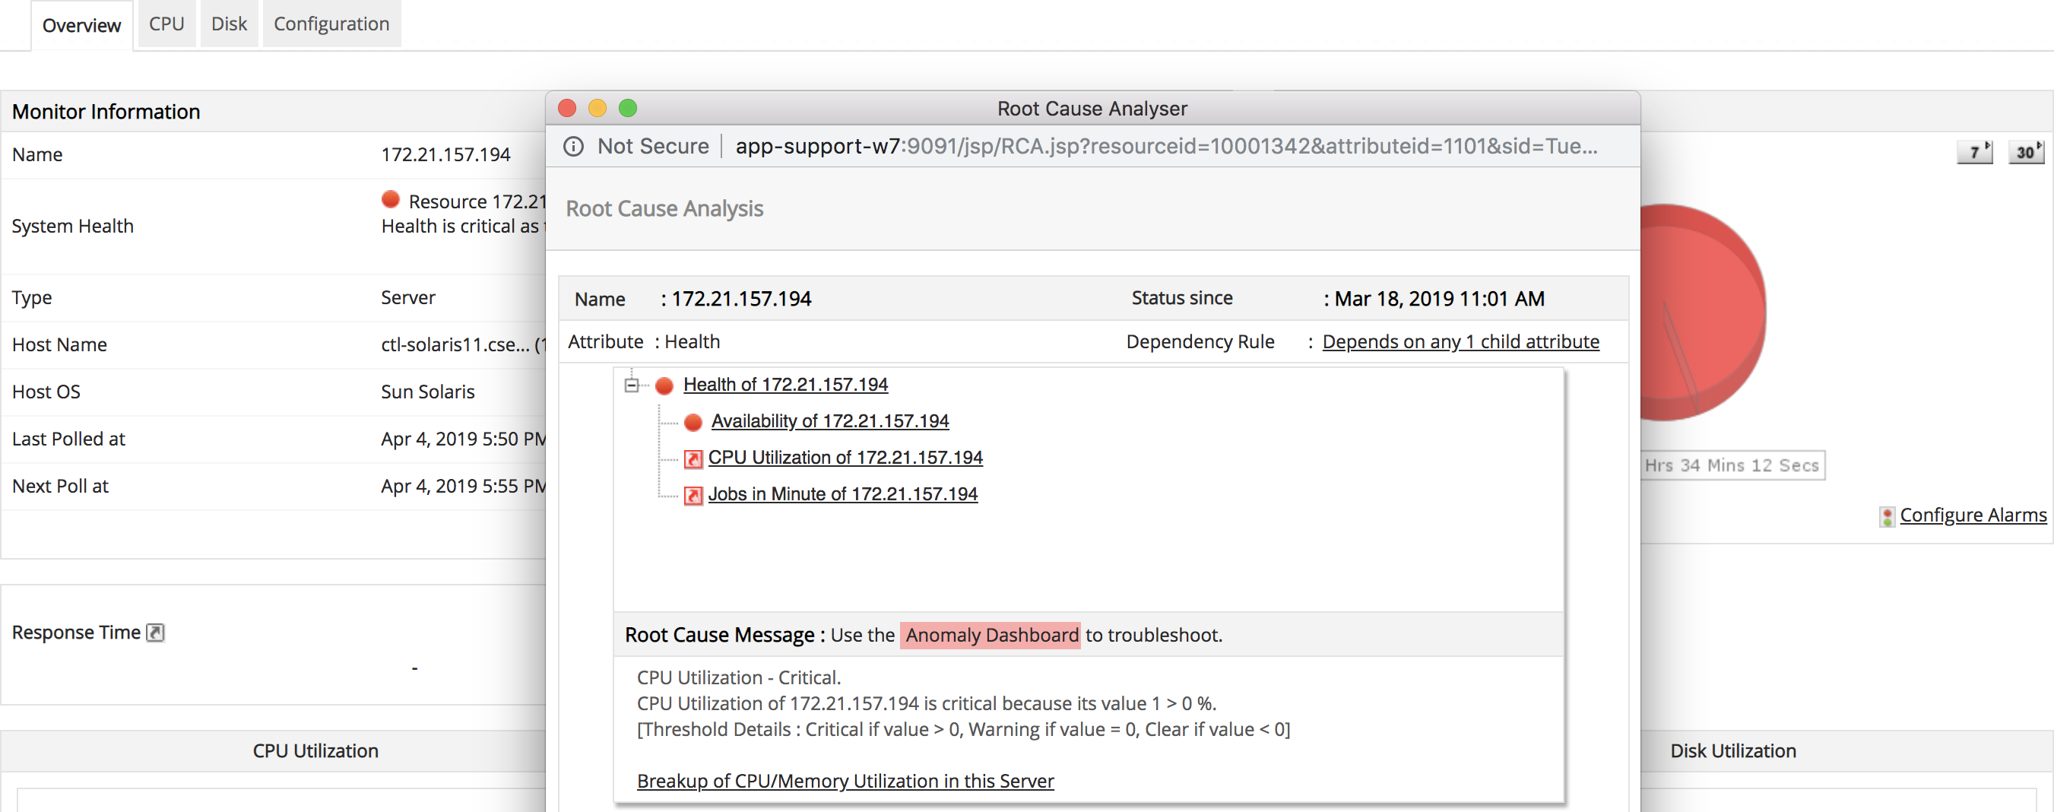
Root Cause Analysis

Slide 22
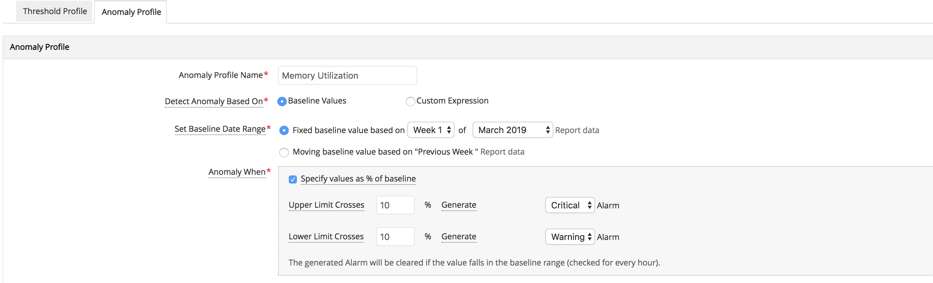
Dynamic baselining

Slide 23
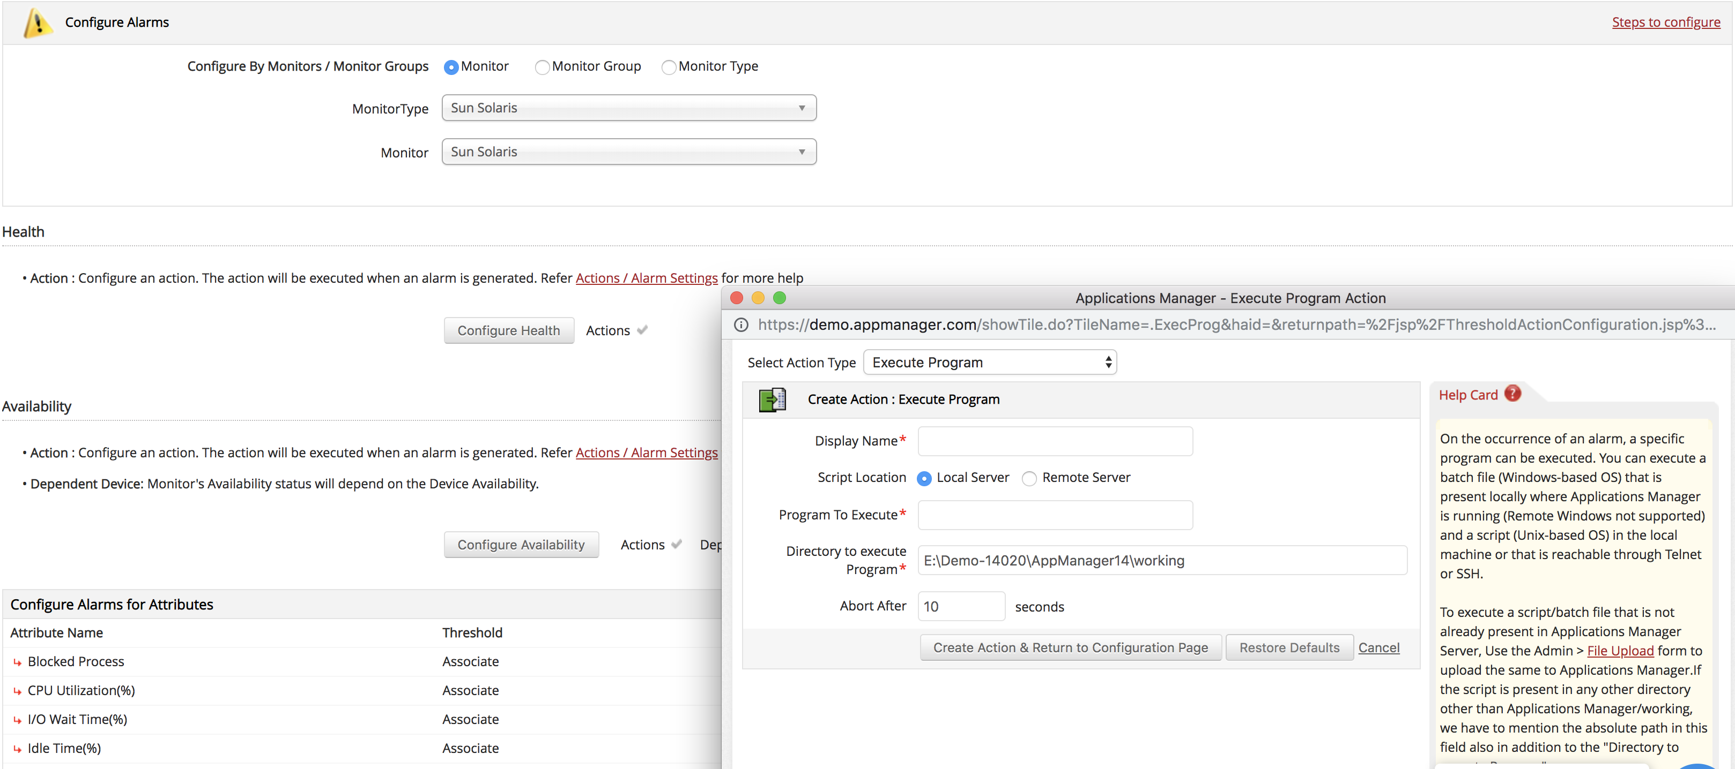
Automate corrective actions

Slide 24
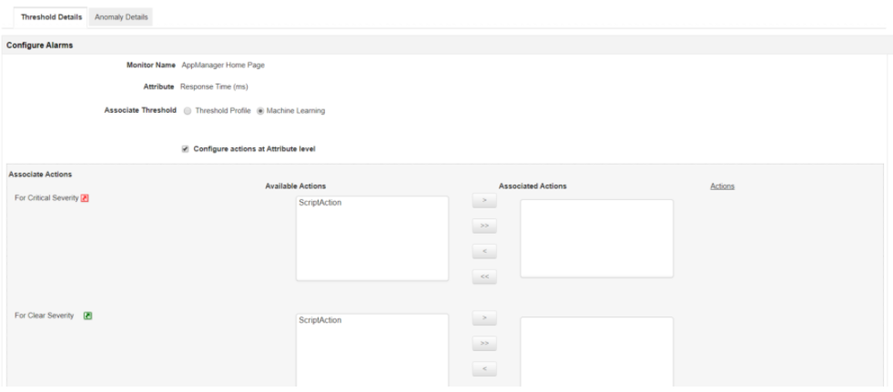
Automate anomaly detection

Slide 25
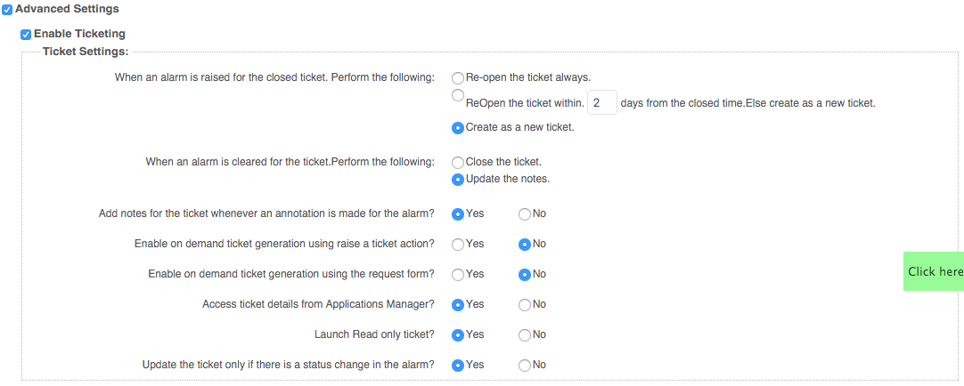
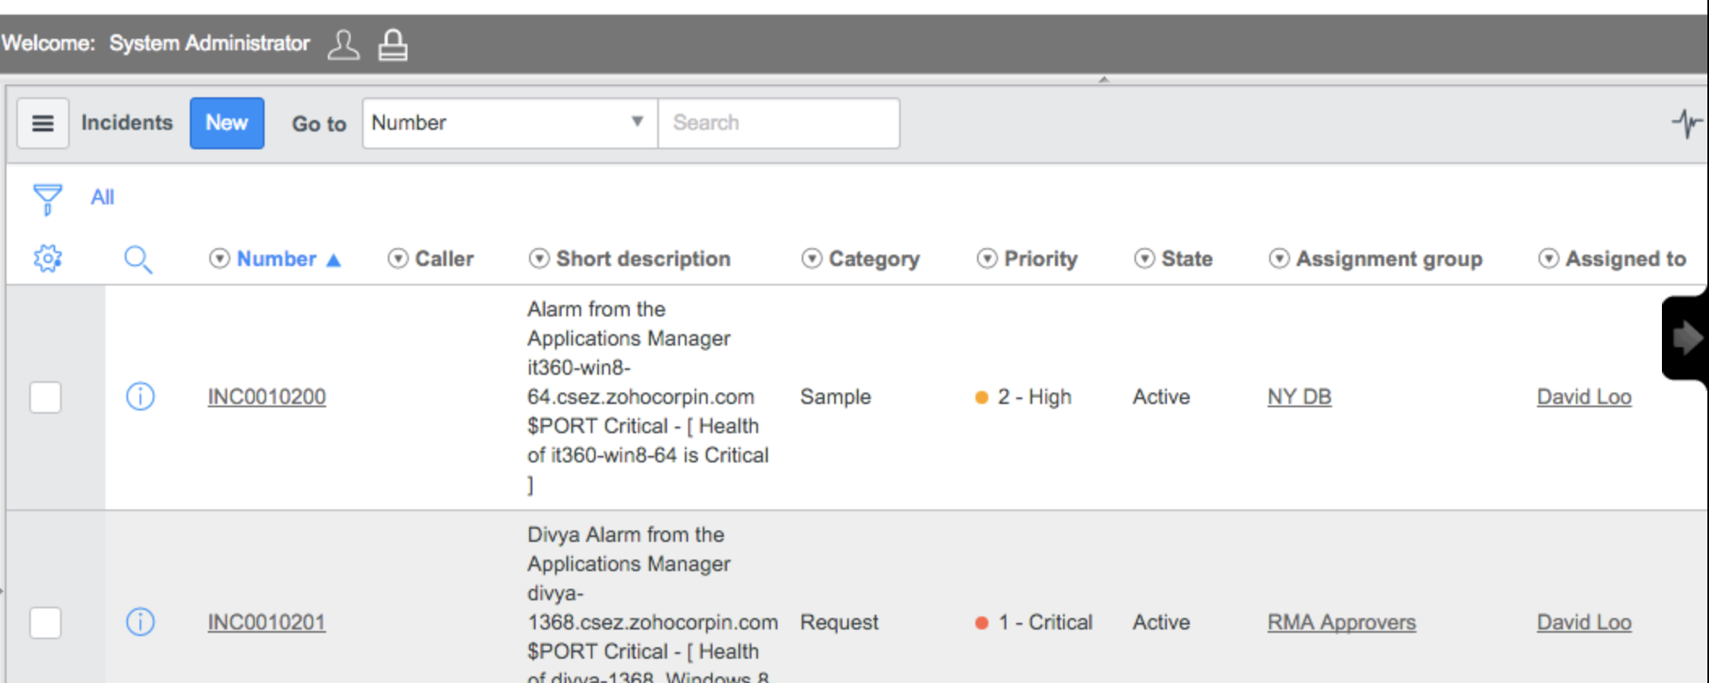
Log a ticket in ServiceNow

Slide 26
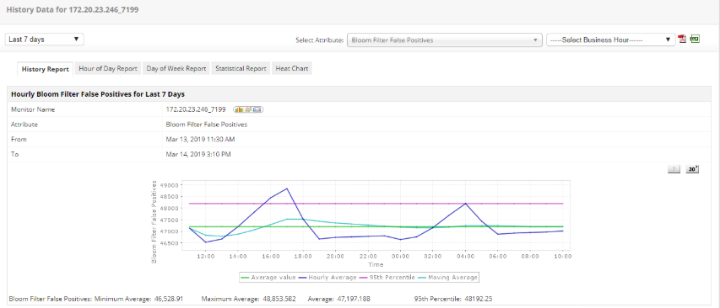
Trend Analysis Report

Slide 27
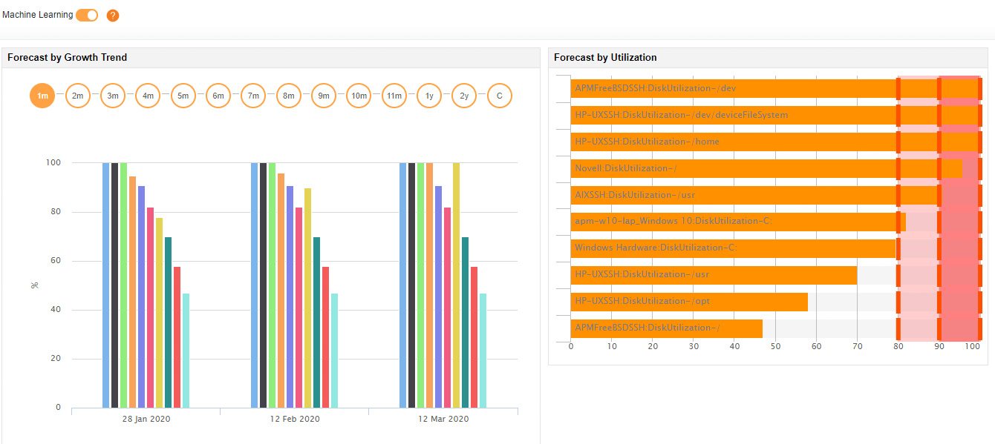
Forecast Report

Slide 28
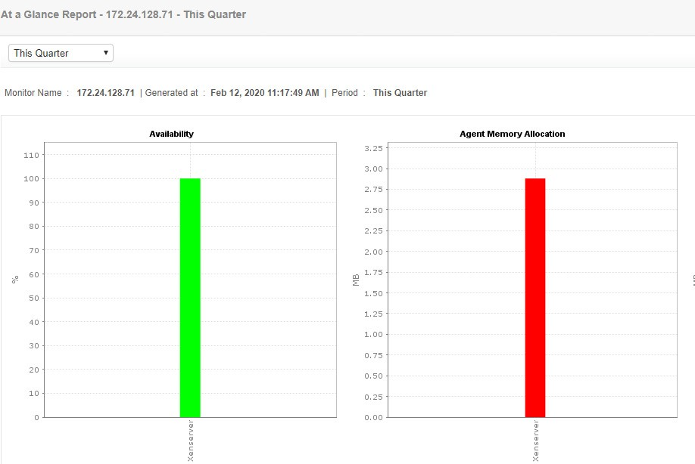
Capacity Planning Report

Slide 29
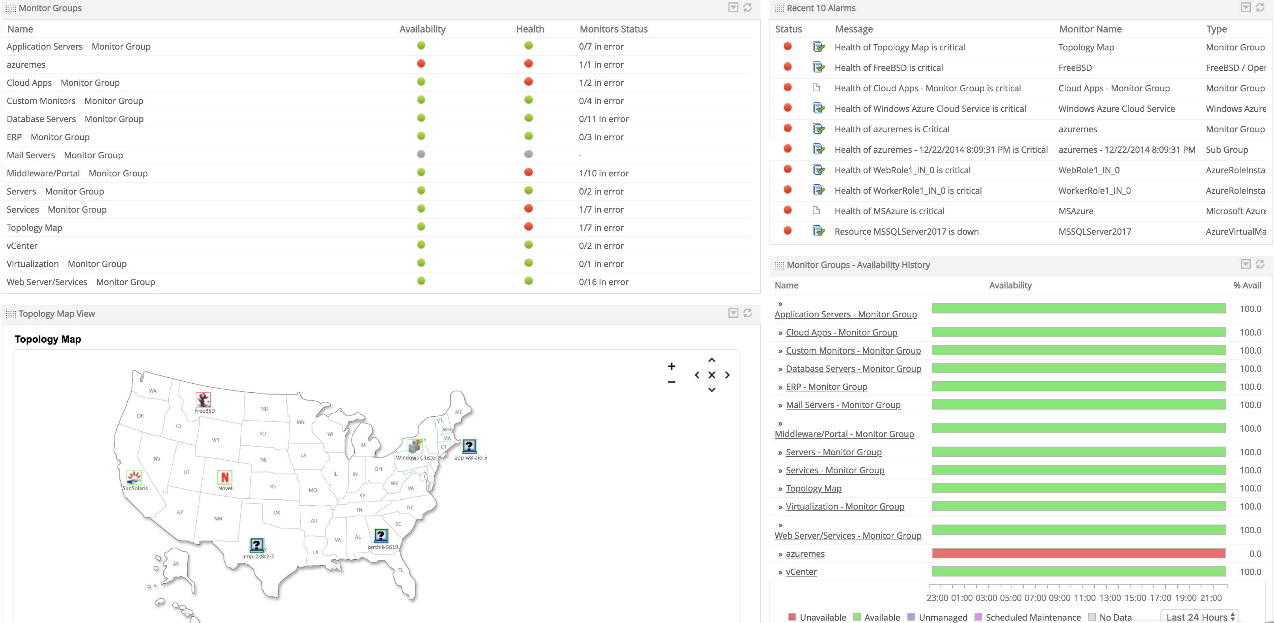
Customizable Dashboards

Slide 30
Other highlights
No need to integrate multiple products or community generated scripts
Easy to use and deploy.
Native mobile apps - iOS and Android
Provides REST APIs to integrate with portals
Flexible deployment options - on premise, AWS & Azure marketplace
Notes:
It is a minute after midnight and the site goes live. Soon after, users complain of several problems. The site is not reachable due to increased traffic. Even if the site is reachable for some people, the landing page appears to be slow. Customers who click on Mobiles and Tablets category leads to HTTP 500 internal server error. Some pages lead to a HTTP 502 bad gateway error. Whatever happened to the Electronics page!! This was nothing short of a disaster..

Slide 31






Why Applications Manager
Quick time-to-value
High scalability
Enterprise-grade security
Low TCO
Friendly support
Transparent pricing & licensing
Low TCO

Slide 32
Available in 2 editions
Professional
Ideal for small to medium businesses
Monitor up to 500 applications based on load
Enterprise
Ideal for medium to large enterprises
Distributed monitoring architecture
Failover support
Notes:
It is a minute after midnight and the site goes live. Soon after, users complain of several problems. The site is not reachable due to increased traffic. Even if the site is reachable for some people, the landing page appears to be slow. Customers who click on Mobiles and Tablets category leads to HTTP 500 internal server error. Some pages lead to a HTTP 502 bad gateway error. Whatever happened to the Electronics page!! This was nothing short of a disaster..

Slide 33

Over 75 educational institutions
Over 100 government organizations
Leading brands across banking, finance, energy, airline, automobile, software, healthcare, hospitality and tourism industries
trust Applications Manager!

Slide 34


What our customers say
"Applications Manager helped me discover and resolve previously unknown, intricate issues faster"
- Atlantic Health System
"I like Applications Manager because it helps us to detect issues present in our servers and SQL databases"
-Lexmark

Slide 35

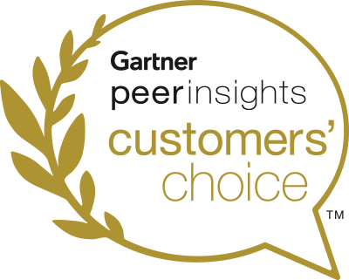
Recognized by Industry Analysts
Featured 9 times in the Gartner MQ for Application Performance Monitoring Suites
Gartner Peer Insights Customers' Choice 2020 for IT Infrastructure Monitoring Tools
Gartner Peer Insights Customers' Choice 2020 for Application Performance Monitoring Suites
Notes:
It is a minute after midnight and the site goes live. Soon after, users complain of several problems. The site is not reachable due to increased traffic. Even if the site is reachable for some people, the landing page appears to be slow. Customers who click on Mobiles and Tablets category leads to HTTP 500 internal server error. Some pages lead to a HTTP 502 bad gateway error. Whatever happened to the Electronics page!! This was nothing short of a disaster..

Slide 36
Thank you

